Slide 1


Sentiment Classification on Drug Reviews Vishaka Jhunjhunwala 500936693

Slide 2

Introduction Classify a whole opinion document (e.g., a review) based on the overall sentiment of the opinion holder Classes: Very Positive, Positive, Neutral, Negative, Very Negative Example: “It works decently, but it's not strong enough for my back pain” Perhaps the widely studied problem

Slide 3
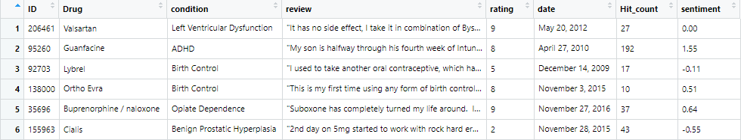
Dataset
Comprises of 7 attributes – ID, Drug, condition, Review, rating, date, Hit count
Added a Sentiment attribute by extracting sentence based opinion

Slide 4
Step By Step Approach
Data Preparation
Pre-processing Text and Corpus Creation
Feature Selection Techniques
Build Model using various classifiers
Evaluate Classifier on test set and document performance metrics

Slide 5
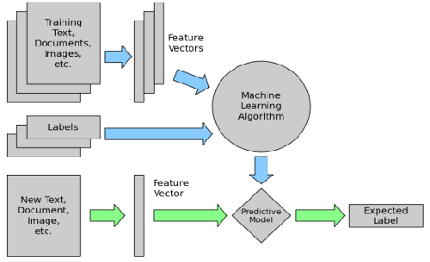
Feature Engineering And Model Building
Two techniques were deployed
Filter based – Information Gain
Hybrid method – Information Gain followed by multinomial regression
Classifiers used to build Model
Naïve Bayes
Random Forest
Decision Trees
Support Vector Machines

Slide 6
Results Observation Set # 1 Comparison between 5 classes and 3 classes model Models were evaluated based on precision , recall and accuracy

Slide 7
Observation Set # 2
Comparison between Filter based and Hybrid based feature selection
Classifier | Precision Information Gain | Precision Hybrid
Naïve Bayes | 18.94 | 19
Decision Trees | 29.45 | 29.6
Random Forest | 37.67 | 38.99
Support vector Machine | 30.12 | 26.24

Slide 8
Observation Set # 3
Cross validation across entire dataset
Random Forest model was better among the other 3 models

Slide 9

Challenges
Harder than topical classification, with which bag of words features perform well
Must consider other features due to…
Subtlety of sentiment expression
irony
expression of sentiment using neutral words
Domain/context dependence
words/phrases can mean different things in different contexts and domains
Effect of syntax on semantic
Sparsing the matrix causes bias

Slide 10

Conclusions and Discussions
Not an effective method for drug review sentiment classification
The random Forest model only returned an accuracy rate of 36.95%.
This model has a precision of about 38.99%, this is not a level that has any utility.

Slide 11


